Slide 1
Opening a Hungarian restaurant in New York
Coursera Capstone project

Slide 2
Goal is to recommend a suitable place in NYC
The project’s main goal is to recommend an area in NYC where an owner could open up a new Hungarian restaurant or venue to eat.
This is achieved by:
Setting up methods / assumptions based on which to do the analysis
Gathering data and respective data sources to be used
Analyze data to find suitable areas
Recommend one or more areas for the owner
Only NYC is considered (not greater metropolitan) and the analysis is simplified - there are more than 26’000 restaurants!

Slide 3
Goal is to recommend a suitable place in NYC
The project’s main goal is to recommend an area in NYC where an owner could open up a new Hungarian restaurant or venue to eat.
This is achieved by:
Setting up methods / assumptions based on which to do the analysis
Gathering data and respective data sources to be used
Analyze data to find suitable areas
Recommend one or more areas for the owner
Only NYC is considered (not greater metropolitan) and the analysis is simplified - there are more than 26’000 restaurants!

Slide 4
Taking two approaches (always have a plan B :)
Method A - Finding areas with already operating similar restaurants
Gather New York Borough and neighborhood data
For each ‘hood find Hungarian and related (Czech, Slovak, Polish, Romanian) restaurants
Explore the result set and find high and low concentration of restaurants
If Method A does not yield a meaningful result, find neighborhoods with the highest density of restaurants in Manhattan.
Only Manhattan areas are considered
Take the 100 top venue in each ‘hood
Do a one-hot encoding
Given the number of venues (and licensing on Foursquare API) small number of clusters are used - group them into 3 clusters by K-Means
Analyze the clusters
Recommend an area or neighborhood

Slide 5
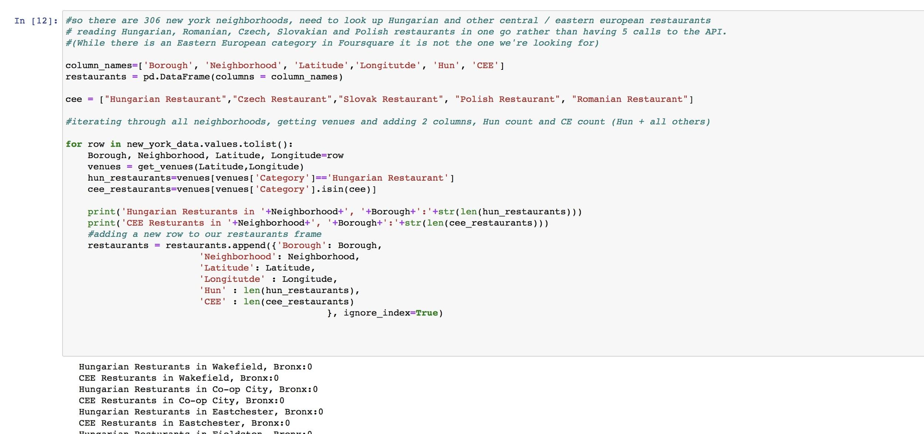
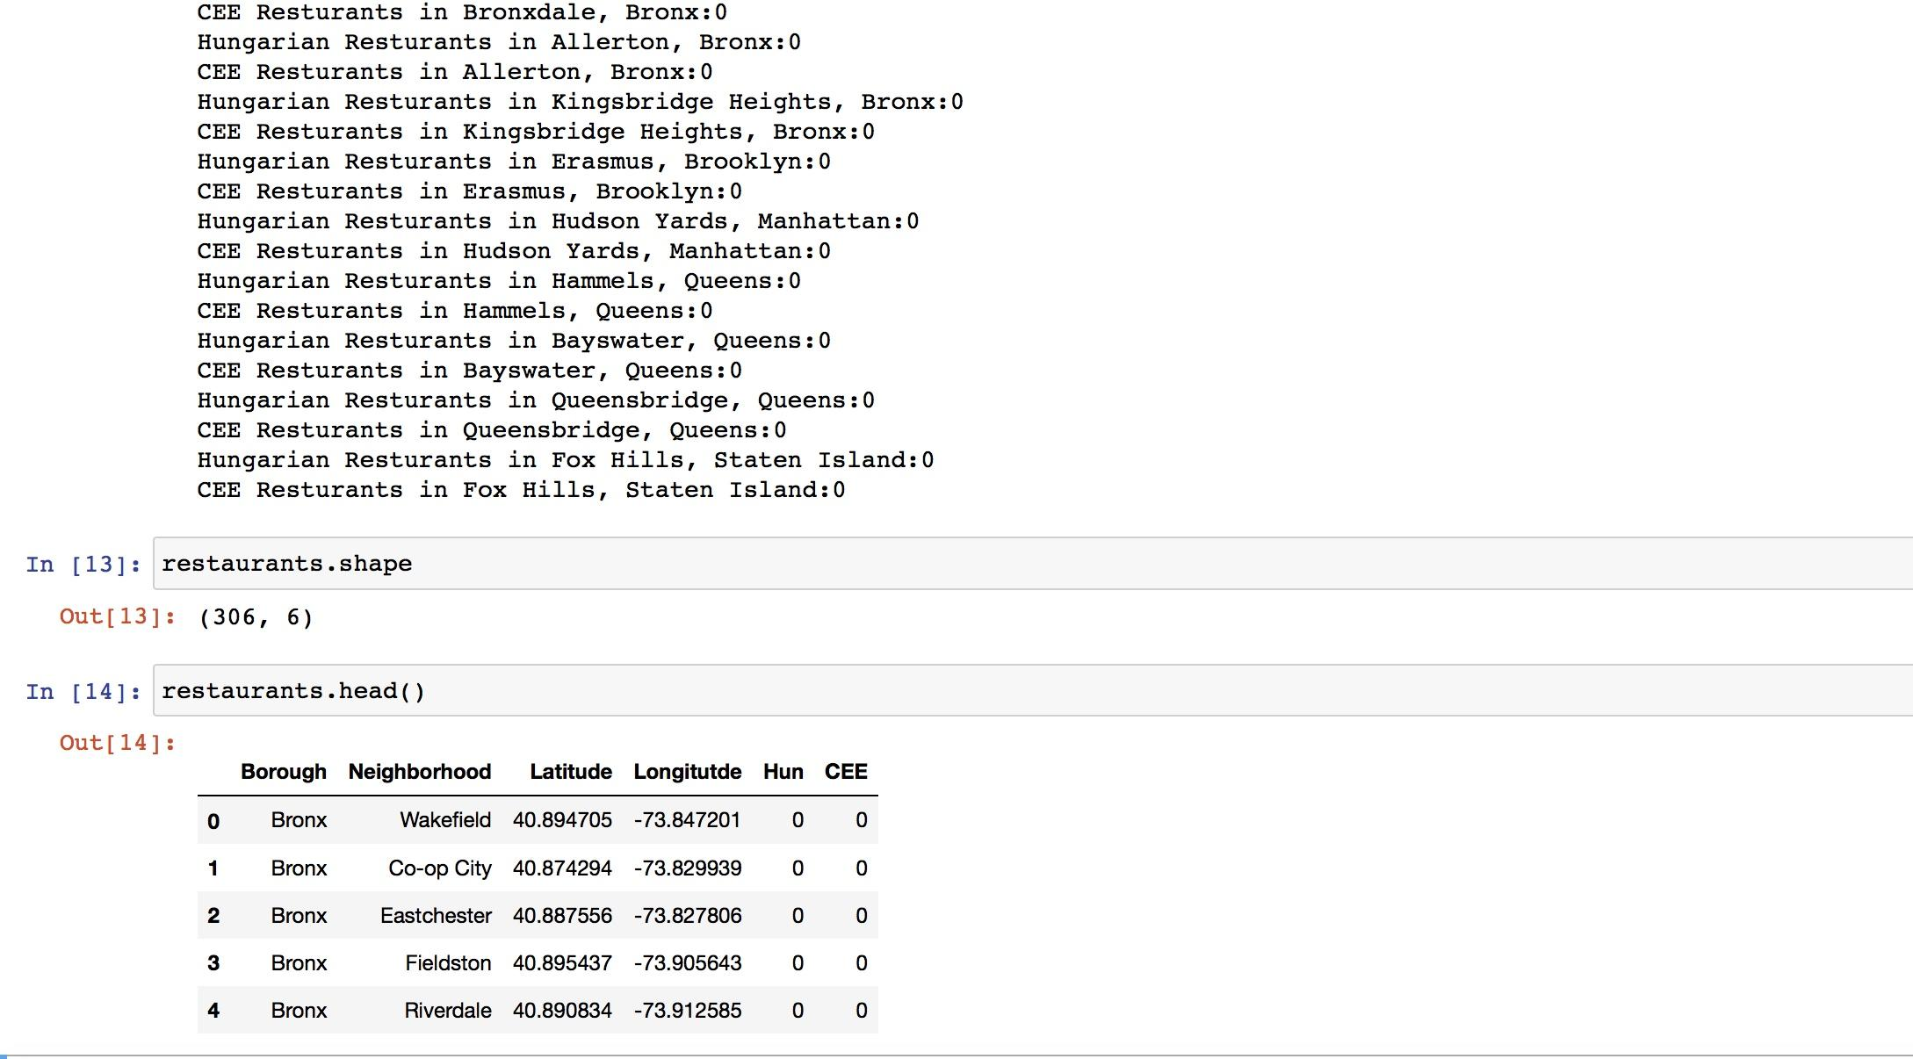
Method A - finding Central European restaurants

Slide 6
Seems like Central Europeans prefer Jersey and Chicago
Method A did return a meaningful result, but does not help to locate a neighborhood.
There are no dedicated Hungarian restaurants in NYC (there are though in Jersey)
There are only 9 places dedicated to Central European cuisine and these are scattered in 7 neighborhoods in 4 boroughs.
3 in one neighborhood is not significant enough
‘Hoods with restaurants of interest:
Greenpoint / Brooklyn : 3
Arrochar / Staten Island : 1
Blissville / Queens : 1
Lenox Hill / Manhattan : 1
Ridgewood / Queens : 1
Roosevelt Island / Manhattan : 1
Steinway / Queens : 1

Slide 7
Finding Manhattan areas with lots of restaurants
This was achieved in a similar way as discussed during the course:
Filtering our source list for Manhattan neighborhoods only
For each ‘hood read the top 100 venues
Group the venues by categories
Run a one hot encoding and K-Means clustering (taking K=3 for simplicity)
Visualize the results
Analyze the clusters to pinpoint areas

Slide 8
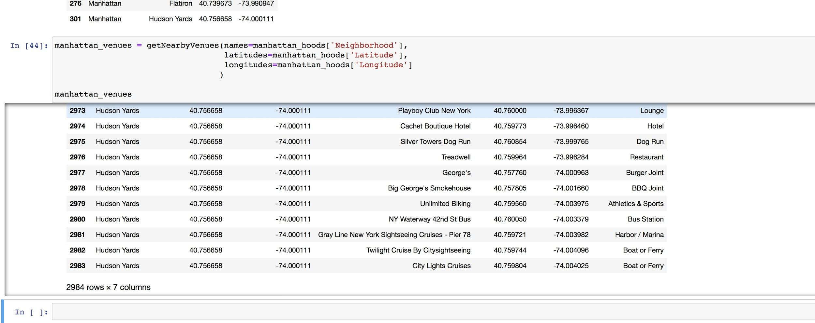
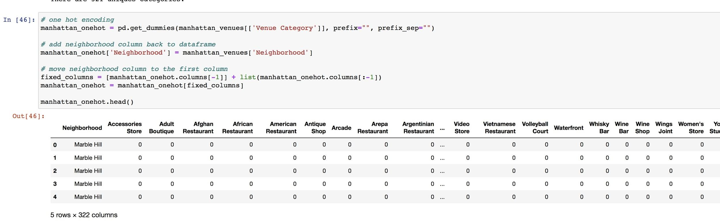
Finding Manhattan areas with lots of restaurants
2984 venues
321 unique categories -> this diversity can affect our results as well

Slide 9
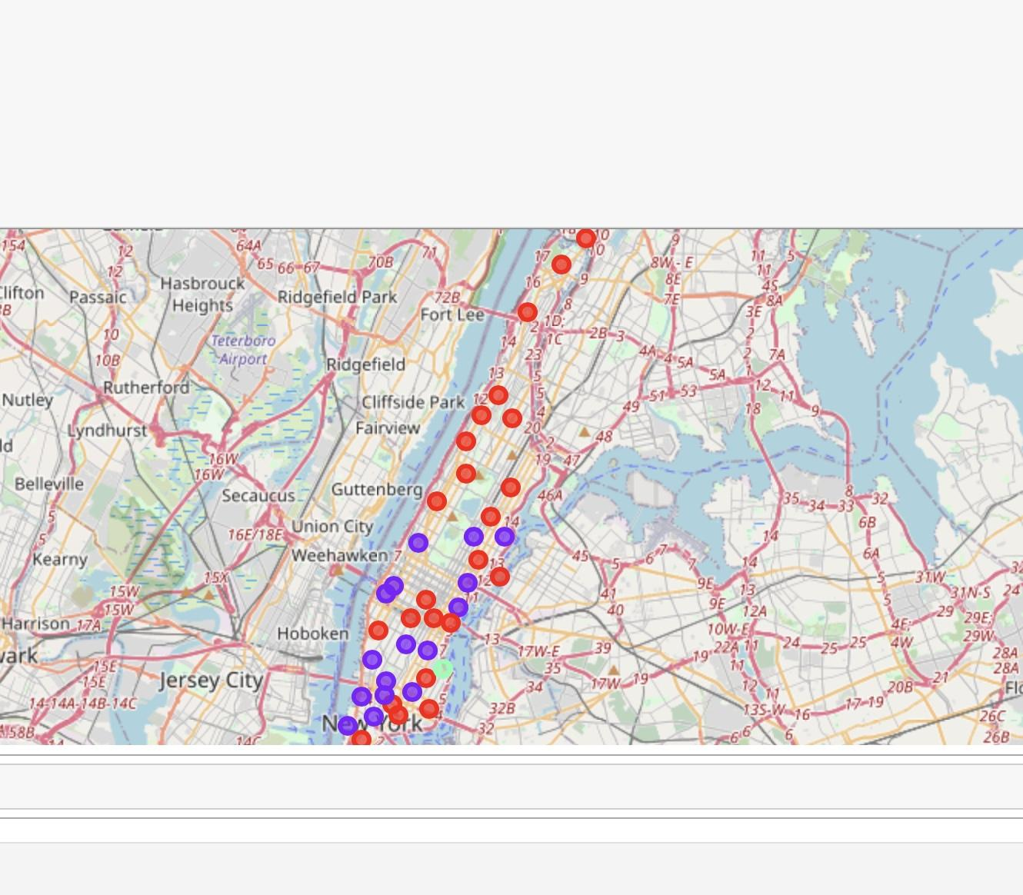
Finding Manhattan areas with lots of restaurants
3 clusters, one can be excluded
There are minor / subtle differences between the 2 interesting clusters
More upscale and concentrated more (not only) on lower Manhattan
Less upscale with more cafes, bakeries, delis and more scattered in high-end residential areas
We can recommend areas based on the type of place the owner wants to open

Slide 10
Recommendation based on what kind of restaurant to open
If the owner wants to open a more upscale niche restaurant with more refined attributes:
Upper East Side
Greenwich Village
Soho
West Village
If the owner wants to open a lower profile restaurant or cafe, deli, bakery:
Marble Hill
Washington Heights
East Village

